Slide 1











Putting People in Their Place: Affordance-Aware Human Insertion in Scenes
Sumith Kulal
Tim Brooks
Alex Aiken
Jiajun Wu
Jimei Yang
Cynthia Lu
Alyosha Efros
Krishna Kumar Singh
CVPR 2023
Notes:
This is joint work with with several members from Adobe Research, UC Berkeley and Stanford and is set to appear at CVPR 2023.

Slide 2
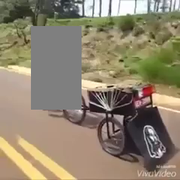
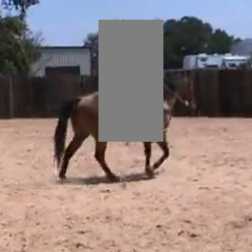

Notes:
Consider the following three images. The humans in each of these images have been masked out. Despite this, we can infer the possible pose a person might take. The surrounding scene context gives a strong signal for this.

Slide 3

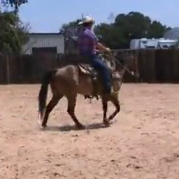

Notes:
At the bottom row are the unmasked images, you might’ve correctly guessed similar poses despite the person being hidden in the original images.

Slide 4
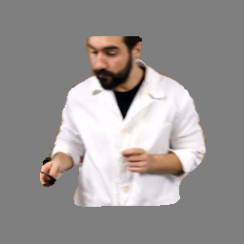
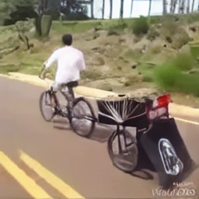
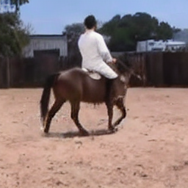

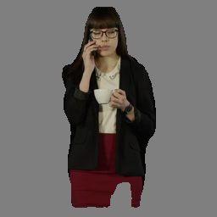
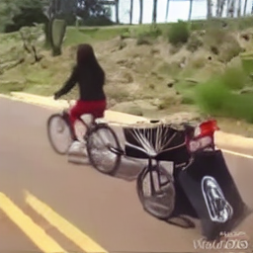
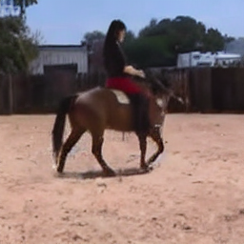
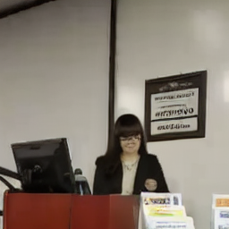
Input Scene
Input Person
Notes:
We were interested in knowing if a generative model could do this. Consider the two people shown on the left, can we realistically insert them into each of these scenes. And the answer is yes we can! Shown here are insertion samples generated by our model.

Slide 5
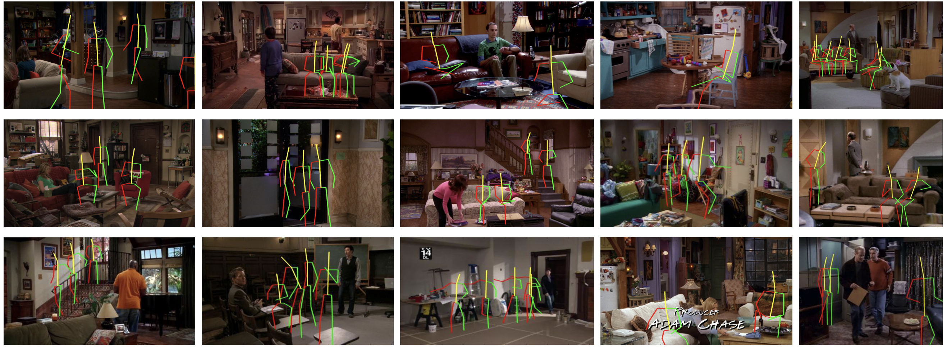
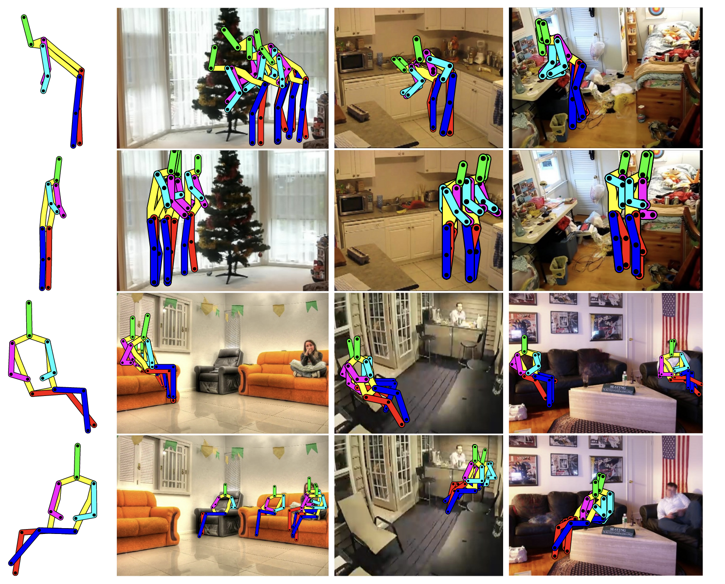
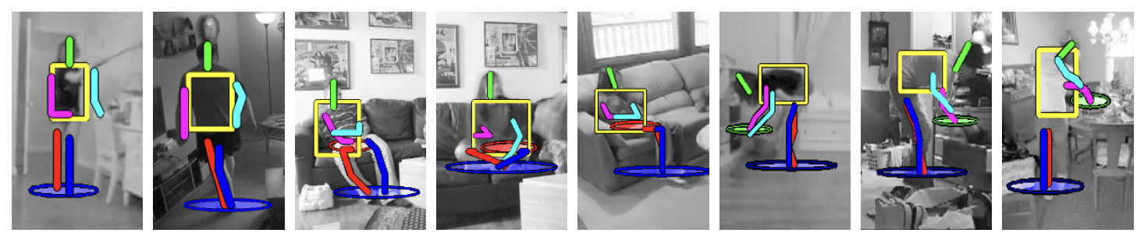
Prior work: Affordance Learning
People Watching: Human Actions as a Cue for Single View Geometry. Fouhey et al.
Scene semantics from long-term observation of people. Delaitre et al.
Binge Watching: Scaling Affordance Learning from Sitcoms. Wang et a.
Notes:
Prior works have used videos of humans moving in scenes to learn affordances. However they are constrained to a small number of scenes and possible poses. Moreover, they only predict the pose and cannot insert a realistic human.

Slide 6
Input Scene
Input Person

Slide 7

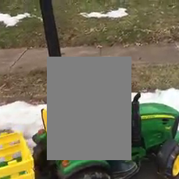
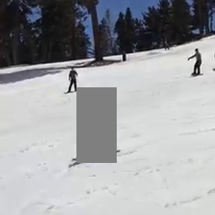
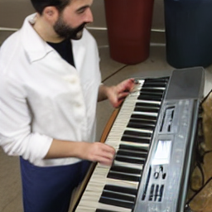
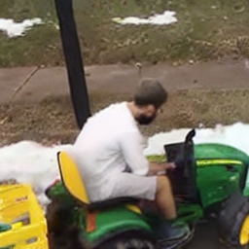
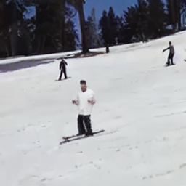
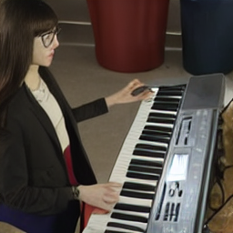
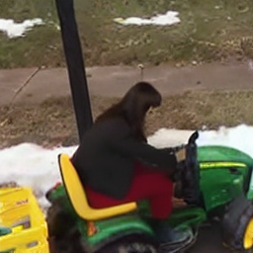
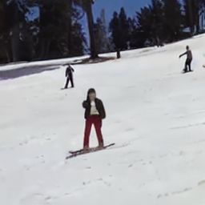
Input Scene
Input Person
Notes:
It also has no specific constraints on the reference person and works on diverse input poses.

Slide 8
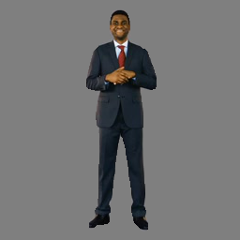
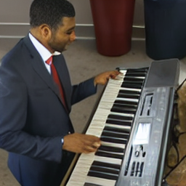
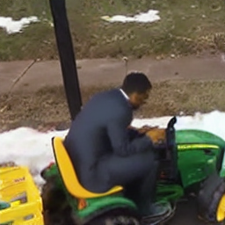
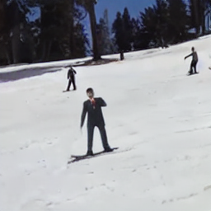
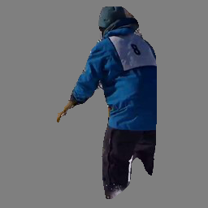
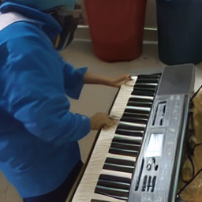
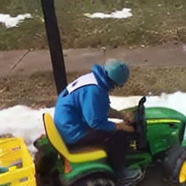
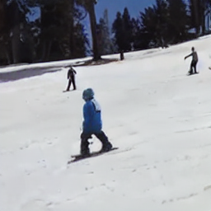
Input Scene
Input Person

Slide 9

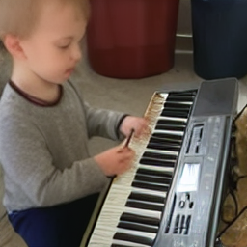
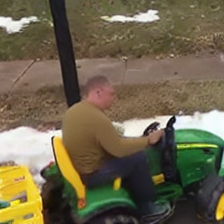
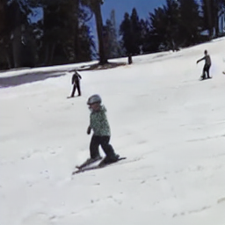
Input Scene
Input Person
Notes:
More over at inference time, one can drop the person conditioning and our model will hallucinate a person in the input scene.

Slide 10
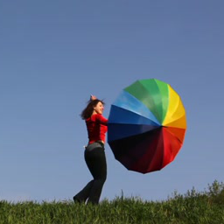


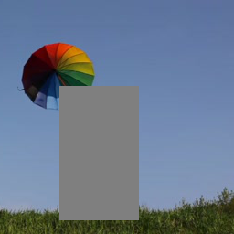
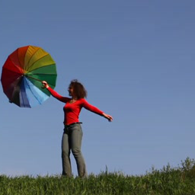
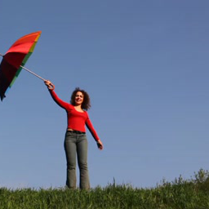
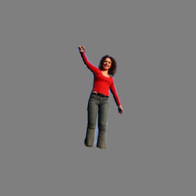
Core Idea
NN
Notes:
Let’s dive into some details on how we train this model. Here’s an overview of learning architecture. Given an input video of a human moving in scene, we borrow two random frames from the video. We mask out the human in one frame and use the second frame as reference to infill the first. This way we generate our training signal in a fully self-supervised manner using videos alone.

Slide 11


Learning Architecture
Target Latent
Masked Image
Latent feature
VAE
VAE
L1 loss
Mask
Noise map
Denoiser
Predicted Latent
Rescale
Rescaled Mask
Mask
+
Center
CLIP
Segmented Person
Notes:
Let’s dive into some details on how we train this model. Here’s an overview of learning architecture. Given an input video of a human moving in scene, we borrow two random frames from the video. We mask out the human in one frame and use the second frame as reference to infill the first. This way we generate our training signal in a fully self-supervised manner using videos alone.

Slide 12
Dataset
Prepared a dataset of humans interacting with diverse scenes.
Inspired by prior work, we search for 256 x 256 spatiotemporal segments with human presence.
Our data source includes public computer vision datasets and internal Adobe data.
Starting with 13 million videos, we ended up 2.4 million clips of interest after processing.
Hallucinating Pose-Compatible Scenes. Brooks et al.
Notes:
We prepared a large-scale dataset of humans interacting with scenes. Starting from a large collection of videos and using object & pose detection tools, we mine spatiotemporal video segments with human presence. We started with 13 million videos, both from public vision datasets and internal data and extracted 2.4 million clips.

Slide 13
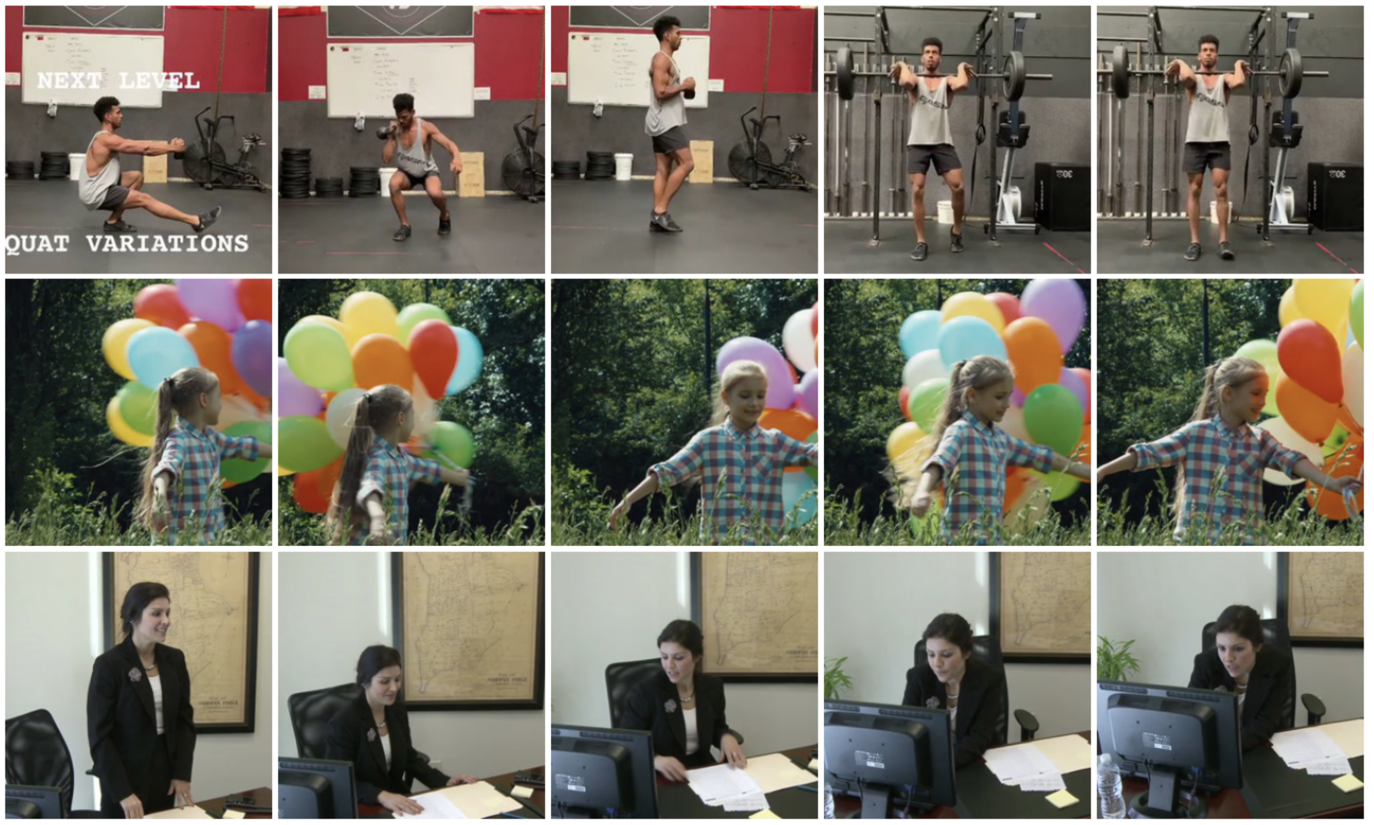
Dataset
Notes:
Here are some frames sampled from our dataset. You can see how the person can have diverse poses within a video and how two frames can generate good reposing supervision.

Slide 14
Learning Architecture
Target Latent
Masked Image
Latent feature
VAE
VAE
L1 loss
Mask
Noise map
Denoiser
Predicted Latent
Rescale
Rescaled Mask
Mask
+
Center
CLIP
Segmented Person
Notes:
Once we sample two frames from a video, we mask out the person in the first frame.

Slide 15
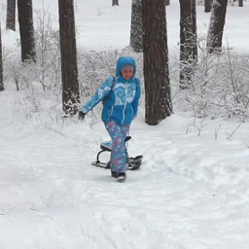
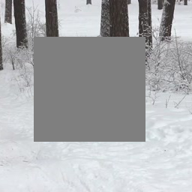
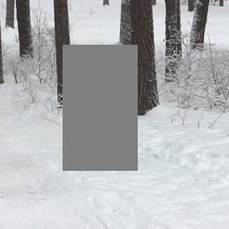
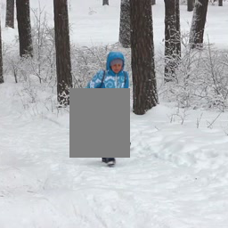
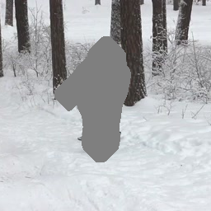
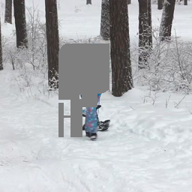
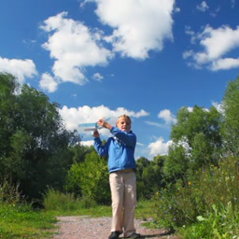

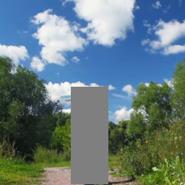
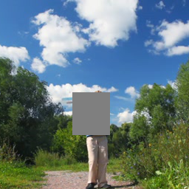
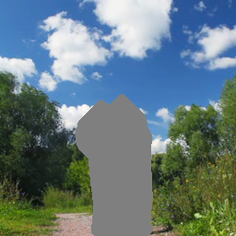
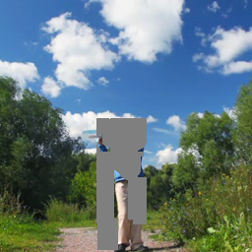
Masking strategy
Masked Image
Mask
Notes:
We employ a combination of different masks including bounding boxes and scribbles. This way we can support generic masks during inference time.

Slide 16
Learning Architecture
Target Latent
Masked Image
Latent feature
VAE
VAE
L1 loss
Mask
Noise map
Denoiser
Predicted Latent
Rescale
Rescaled Mask
Mask
+
Center
CLIP
Segmented Person
Notes:
From the second frame, we borrow the reference person.

Slide 17
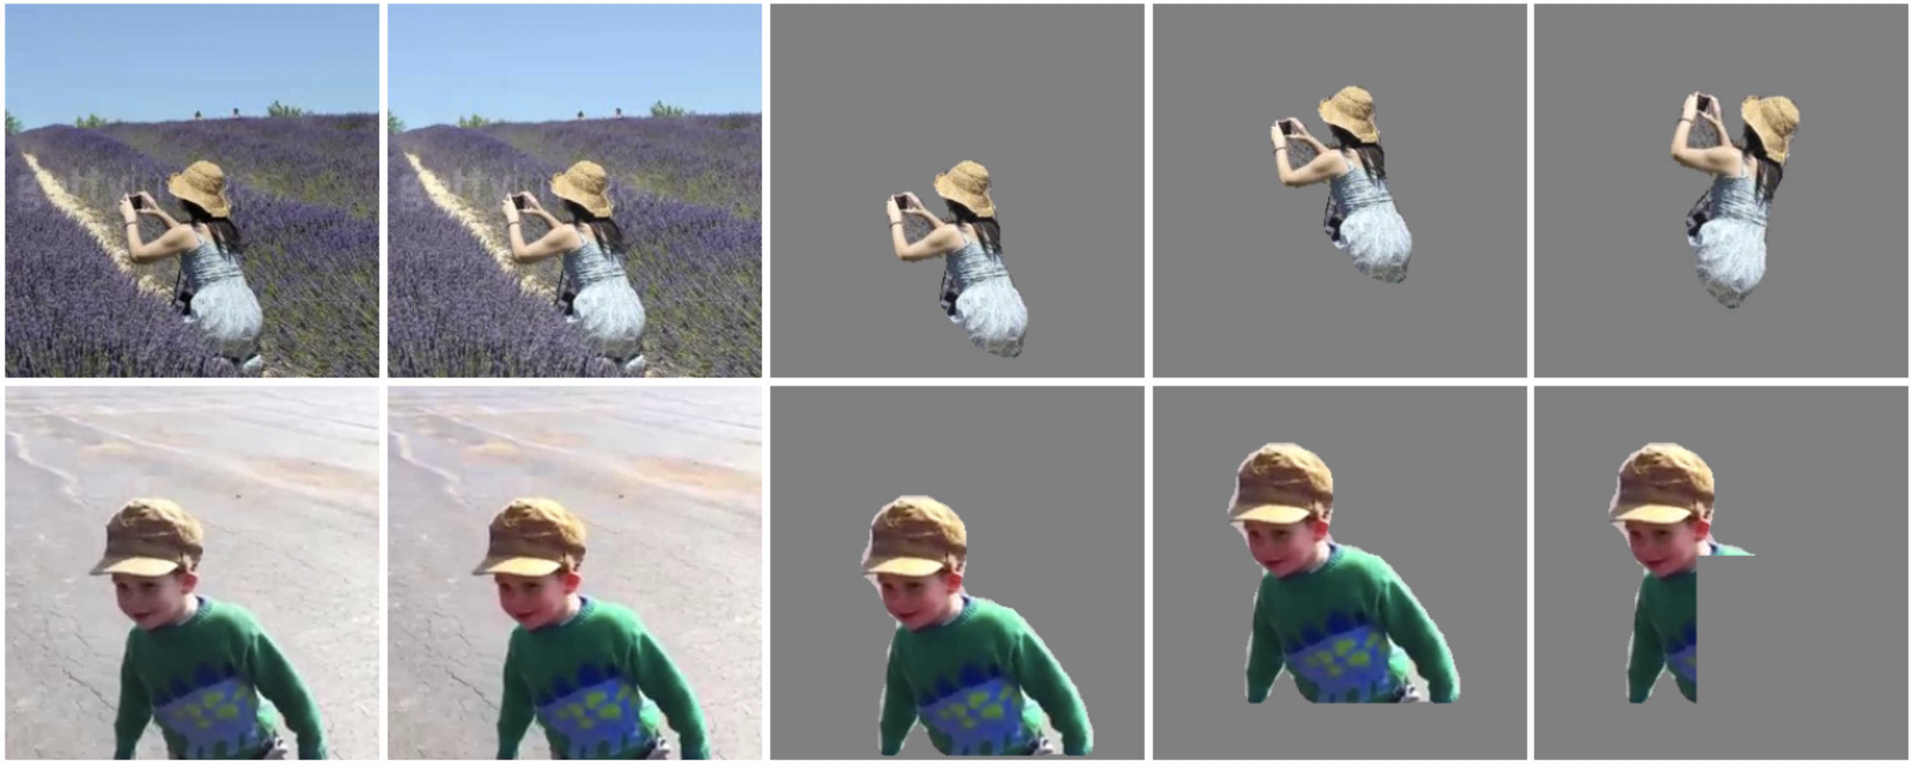
Reference person
Mask
+
Center
Segmented Person
Notes:
Given a reference frame, we mask out and center the person for uniformity. We also apply random color and geometric augmentations at this stage.

Slide 18
Learning Architecture
Target Latent
Masked Image
Latent feature
VAE
VAE
L1 loss
Mask
Noise map
Denoiser
Predicted Latent
Rescale
Rescaled Mask
Mask
+
Center
CLIP
Segmented Person
Notes:
Finally, these inputs are passed into a denoising U-Net.

Slide 19
Denoising U-Net
Latent feature
Follows standard distributed training procedures.
Input scene passed through concatenation.
Refer person passed through cross-attention
Classifier-free guidance by dropping both the conditioning.
Noise map
Denoiser
Rescaled Mask
Notes:
The architecture for the U-Net has 900M params and closely follows Stable Diffusion inpainting architecture. We pass the input scene through concatenation. We also pass CLIP embeddings of the reference person through cross attention. We trained our models with a batch size 1024 on 32 A100s. We tried scaling the batch size further but the returns were marginal. We also employ classifier-free guidance by dropping both conditioning modalities.

Slide 20
Learning Architecture
Target Latent
Masked Image
Latent feature
VAE
VAE
L1 loss
Mask
Noise map
Denoiser
Predicted Latent
Rescale
Rescaled Mask
Mask
+
Center
CLIP
Segmented Person
Notes:
Finally, we use reconstruction loss on the first frame as our training objective.

Slide 21









Person Conditioned Insertions
Scenes
Input
Samples
Notes:
Here are some results. We insert the input person on the left into the scenes on the top. You can see how the boy here interacts with the curtain, sofa and bicycle after significant reposing and harmonization.

Slide 22









Person Conditioned Insertions
Scenes
Input
Samples

Slide 23









Person Conditioned Insertions
Scenes
Input
Samples
Notes:
Another set of samples here. You can see the skirt waving away in the beach scene and also how she has the right pose to play the piano.

Slide 24









Person Conditioned Insertions
Reference
Input
Samples
Notes:
Here are some samples of inserting different people into the same scene. All the reference people here are successfully reposed to perform a deadlift.

Slide 25









Person Conditioned Insertions
Reference
Input
Samples
Notes:
Here are some samples of inserting different people into the same scene. All the reference people here are successfully reposed to perform a deadlift.

Slide 26









Person Conditioned Insertions
Reference
Input
Samples
Notes:
We also support generic masks at inference time demonstrated here. Everybody is in a waving pose due to the input mask.

Slide 27









Person Conditioned Insertions
Reference
Input
Samples
Notes:
We also support generic masks at inference time demonstrated here. Everybody is in a waving pose due to the input mask.

Slide 28
Architecture ablations - Data
Method | FID | PCKh
Image (w/o aug) | 13.174 | 8.321
Image (w/ aug) | 13.008 | 10.660
Video (w/o aug) | 12.103 | 15.797
Video (w/ aug) | 10.078 | 17.602
Video data is crucial for our task.
Using image-only data even with augmentations doesn’t work.
Notes:
We evaluate our model on two quantitative metrics, FID for image quality and PCKh (which is the percentage of correct keypoints with respect to ground-truth) for semantic correctness. We observe that using videos is crucial to doing the task well. Image only data even with augmentations doesn’t do that well.

Slide 29
Architecture ablations - Scaling
Method | FID | PCKh
Small (400M, scratch) | 12.366 | 15.095
Large (scratch) | 11.232 | 15.873
Large (fine-tune) | 10.078 | 17.602
Smaller scale models do not perform as well.
Initialization with Stable-Diffusion weights help.
Notes:
We also observed that smaller scale models perform poorly. Training from scratch is decent but initializing with Stable Diffusion weights gives us a bump in quality.

Slide 30










Person Hallucinations
Ground-Truth
Input
Samples
Notes:
The magical power of these models is being able to prompt them different at inference time. If we pass NULL conditioning for the person alone, our model can hallucinate realistic people into the scene.

Slide 31










Person Hallucinations
Ground-Truth
Input
Samples

Slide 32










Person Hallucinations
Ground-Truth
Input
Samples
Notes:
Some here are some more samples.

Slide 33


Classifier-Free Guidance
Effect of increasing CFG guidance scale. Evaluated at scale values [1.0, 1.5, 2.0, 3.0, 4.0, 5.0, 6.0]
Person Conditioned
Person Hallucination
Notes:
Classifier free guidance is crucial for our model. Here we show the effect of varying CFG scales. We observed quality and semantic correctness improve with CFG upto a certain point.

Slide 34










Person Hallucinations - Baselines
Ground-Truth
Input
DALL-E 2
Stable-Diffusion v1.5
Ours
Notes:
Here are some baseline comparisons with DALL-E and Stable Diffusion. We observe that our model does a better job of taking scene context into account and synthesizing images with proper afforances, for example in the bathroom sink at the top.

Slide 35










Constrained Scene Hallucination
Ground-Truth
Input
Samples
Notes:
We can also perform scene hallucination. At inference time, we pass empty conditioning for the scene image and our model predicts a plausible scene for the person.

Slide 36










Constrained Scene Hallucination - Baselines
Ground-Truth
Input
DALL-E 2
Stable-Diffusion v1.5
Ours
Notes:
Our model can synthesize scenes better than Stable Diffusion and comparable to DALL-E 2.

Slide 37










Unconstrained Scene Hallucination
Ground-Truth
Input
Samples

Slide 38









Partial Body Completions
Reference
Input
Samples
Notes:
If given a partial human body in the input, our model successfully identifies it and completes it as shown here.

Slide 39








Partial Body Completions
Reference
Input
Samples
Notes:
If given a partial human body in the input, our model successfully identifies it and completes it as shown here.

Slide 40








Partial Body Completions
Reference
Input
Samples
Notes:
If given a partial human body in the input, our model successfully identifies it and completes it as shown here.

Slide 41







Cloth Swapping
Reference clothes
Input
Samples
Notes:
One can also just mask out the clothes in the input and swap it with different people. Shown here is the girl playing the piano in diverse clothing.

Slide 42








Cloth Swapping
Reference clothes
Input
Samples
Notes:
One can also just mask out the clothes in the input and swap it with different people. Shown here is the girl playing the piano in diverse clothing.

Slide 43





Failure Cases
Faces & limbs are bad due to Stable Diffusion’s VAE.
Harmonization is off (top).
Humans not fully reposed (bottom).
Notes:
Our model has a few failure cases that we are working on improving. Most noticeable is the poor face & limb structure. This is a known issue with Stable Diffusion’s autoencoder. Some other failure cases include challenging harmonization and input poses.

Slide 44
In summary
Person Conditioned
Affordance Insertions
Constrained Scene Hallucination
Insertions
Person Hallucination
Unconstrained Scene Hallucination
Affordances
Partial Body Completion
Clothes Swapping
Pixels
Putting People in Their Place: Affordance-Aware Human Insertion into Scenes. CVPR 2023
Notes:
To summarize, I presented a large-scale diffusion model that does affordance-aware human insertion. At inference time, the model can be prompted to diverse downstream tasks.

